Slide 1
What is Pi?

Slide 2
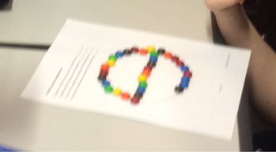
Use you M&M’s as a way to measure the distance across your circle.
Then use the M&M’s to measure the circumference of this circle.
Use this to fill in the table for each circle.
Circle | Diameter | Circumference | Diameter ÷ Circumference
A | 2 | 6 | 6÷2 = 3
B
C
D
E
F

Slide 3
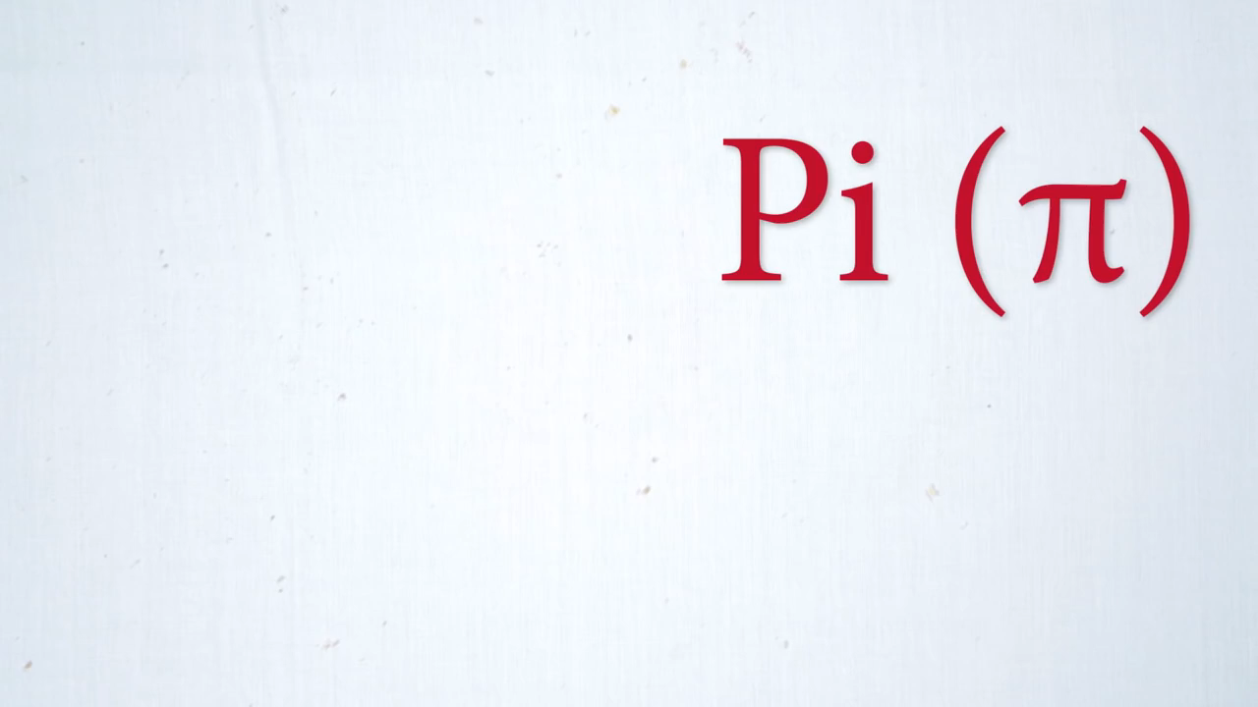

Slide 4
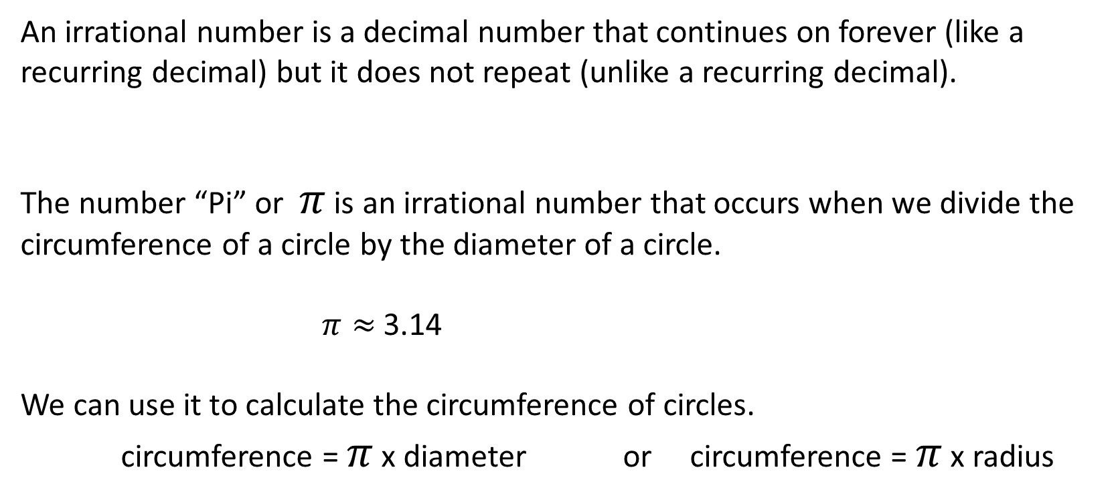
Topic: Pi
EQ: How do we get the number “Pi”?
An irrational number is a decimal number that continues on forever (like a recurring decimal) but it does not repeat (unlike a recurring decimal).
The number “Pi” or $π$ is an irrational number that occurs when we divide the circumference of a circle by the diameter of a circle.
$π≈$3.14
We can use it to calculate the circumference of circles.
circumference = $π$ x diameter or circumference = $π$ x radius

Slide 5
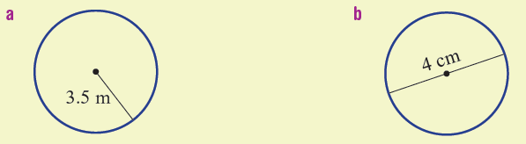
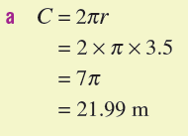
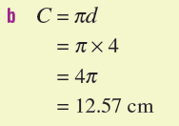
Let’s do some together

Slide 6
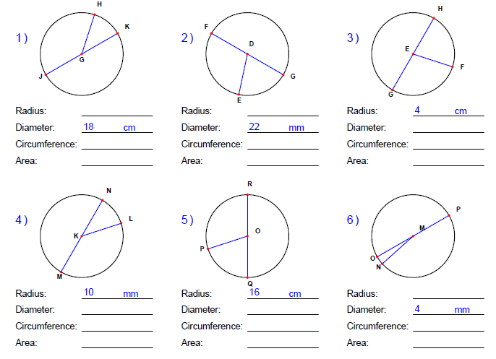

Slide 7
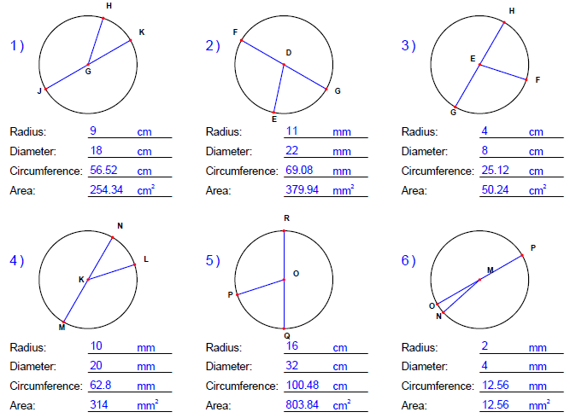

Slide 8
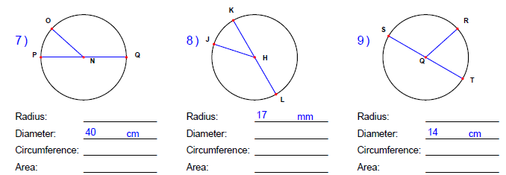

Slide 9
